Slide 1



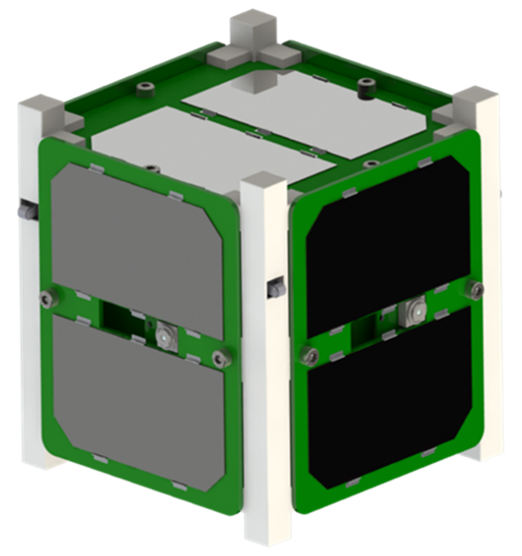
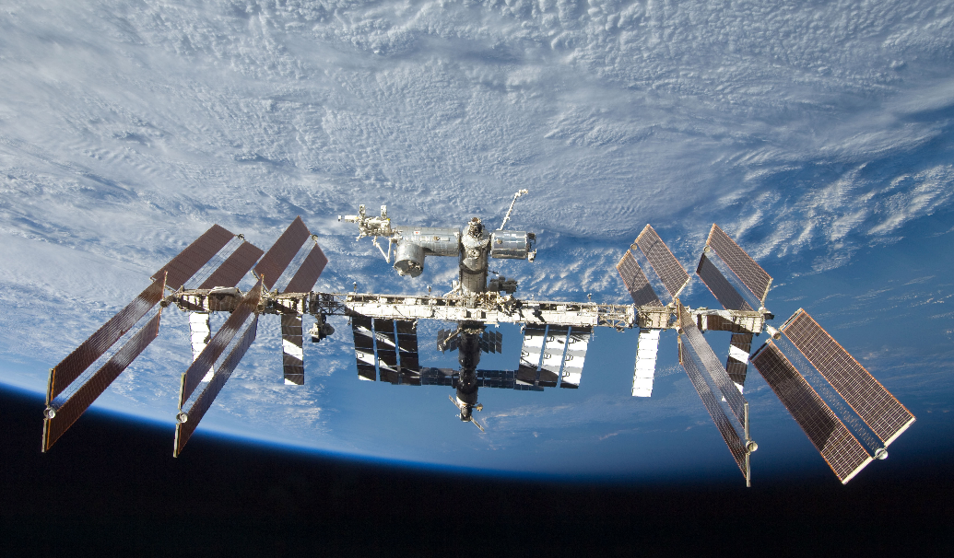
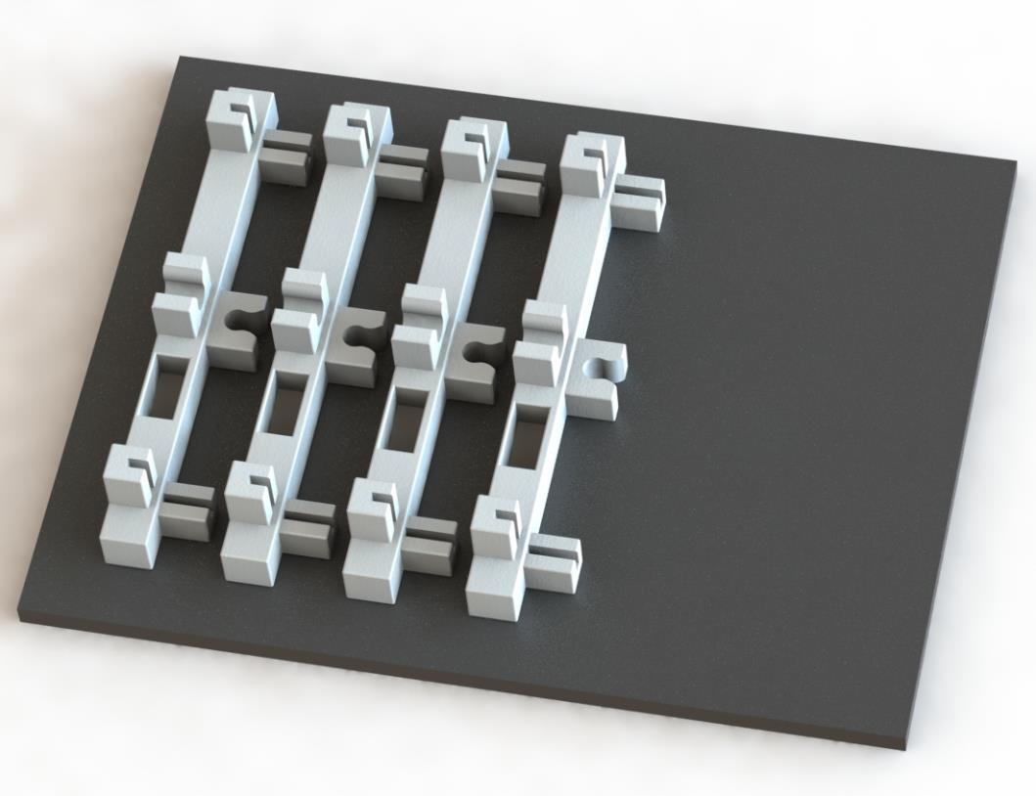
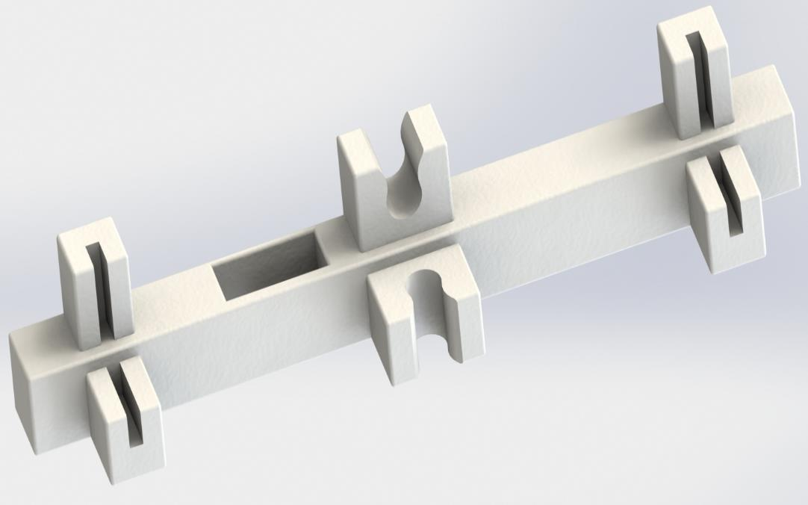
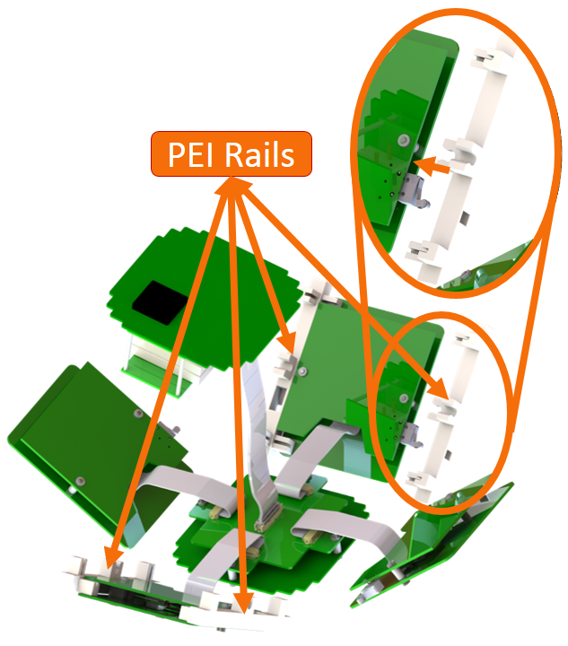
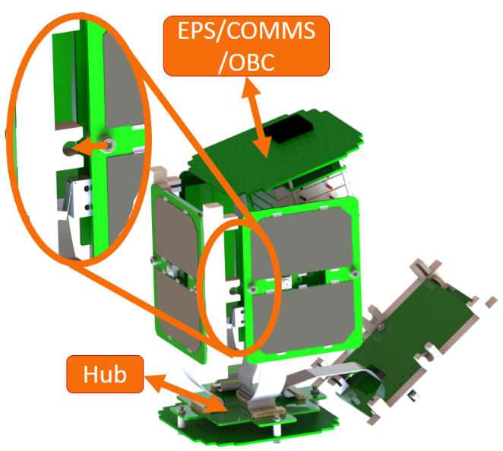
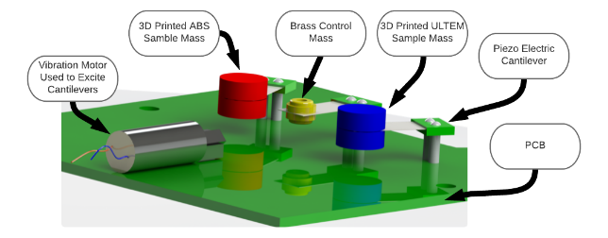
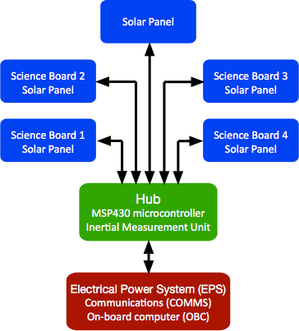
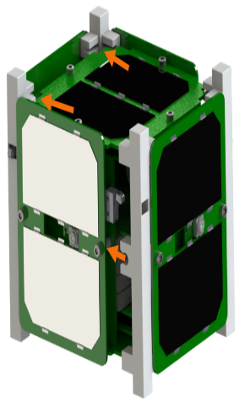
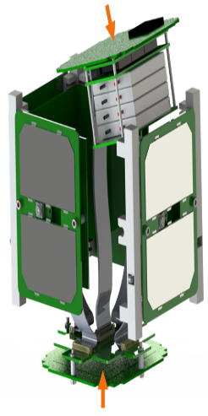
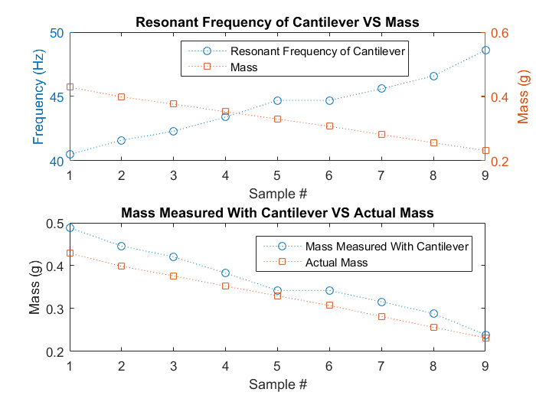
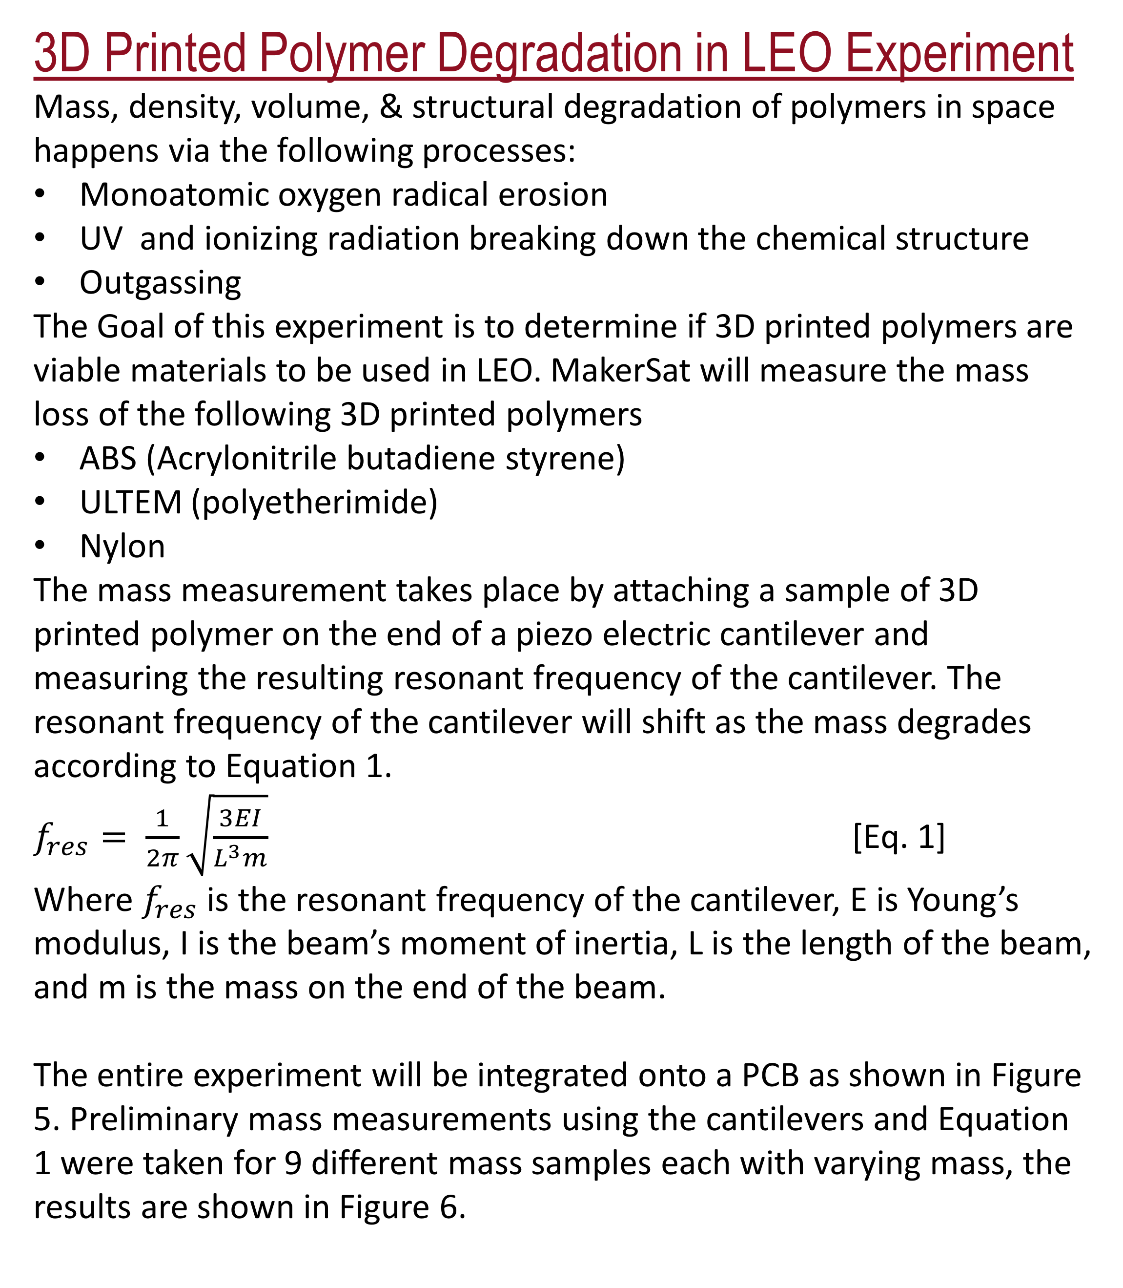
MakerSat: A CubeSat Designed for In-Space 3D Print and Assembly
Connor Nogales, Aaron Ewing, Grant Johnson, Braden Grim, Mitch Kamstra,
Dr. Joshua Griffin, Dr. Steve Parke
Northwest Nazarene University, Department of Physics and Engineering
Introduction
MakerSat is an innovative CubeSat designed to be 3D printed, assembled, and deployed on the ISS. It is also a multi-project satellite that can contains up to four experiments from student or small company teams. MakerSat lowers the time, cost, and complexity barriers to space science experiments and will help pioneer space manufacturing.
3D Printed Structure and Assembly
The frame of MakerSat is specifically designed to be printed on the ISS in their 3D printer called the Additive Manufacturing Facility (AMF) and assembled on the ISS. The frame of MakerSat that holds the satellite together is shown in Figure 3. Each individual piece of the frame is referred to as a rail. These are designed to be printed on the ISS
3D Printed Polymer Degradation in LEO Experiment
Mass, density, volume, & structural degradation of polymers in space happens via the following processes:
Monoatomic oxygen radical erosion
UV and ionizing radiation breaking down the chemical structure
Outgassing
The Goal of this experiment is to determine if 3D printed polymers are viable materials to be used in LEO. MakerSat will measure the mass loss of the following 3D printed polymers
ABS (Acrylonitrile butadiene styrene)
ULTEM (polyetherimide)
Nylon
The mass measurement takes place by attaching a sample of 3D printed polymer on the end of a piezo electric cantilever and measuring the resulting resonant frequency of the cantilever. The resonant frequency of the cantilever will shift as the mass degrades according to Equation 1.
$f_{res}= \frac{1}{2π}\sqrt{\frac{3EI}{L^{3}m}}$ [Eq. 1]
Where $f_{res}$ is the resonant frequency of the cantilever, E is Young’s modulus, I is the beam’s moment of inertia, L is the length of the beam, and m is the mass on the end of the beam.
The entire experiment will be integrated onto a PCB as shown in Figure 5. Preliminary mass measurements using the cantilevers and Equation 1 were taken for 9 different mass samples each with varying mass, the results are shown in Figure 6.
http://www.imgbase.info/images/safe-wallpapers/space/space_mission/48542_space_mission_iss.jpg
http://www.imgbase.info/images/safe-wallpapers/space/space_mission/48542_space_mission_iss.jpg
Figure 1: MakerSat and the ISS.
http://www.imgbase.info/images/safe-wallpapers/space/space_mission/48542_space_mission_iss.jpg
Project Motivation
High-G launches require satellites to be overdesigned
Less rigid/more delicate satellites can be designed to function in micro-gravity
Manufacturing in space reduces packaging and support material required for equipment to survive launch
Less overall mass and space taken up during launch
Figure 3: ULTEM rails to be printed on the ISS
Figure 4 consists of the assembly process of MakerSat. The design of the frame allows MakerSat to simply snap and slide together in an easy and micro-gravity friendly method.
Project Objectives
MakerSat is a proof of concept mission aimed towards validating and pioneering space manufacturing. Mission goals are to:
Demonstrate in space additive manufacturing and assembly on the ISS
Demonstration of a multi-user satellite architecture
Measure various 3D printed polymer’s mass loss over mission duration
Take photographs of Earth
Multi-User Architecture
MakerSat’s multi-user architecture supports up to 4 science teams using MakerSat’s science boards to do experiments. Currently MakerSat is hosting the polymer degradation experiment designed by members of the MakerSat team (described in this presentation) as well as a pre-engineering team from Caldwell High School in Caldwell Idaho.
Figure 5: 3D representation of board layout
Flight Opportunities
MakerSat has a launch scheduled for December 2017 through ELaNa XX. The orbit of this flight is a 500km, 90 degree inclination polar orbit launched by Virgin Galactic. A future MakerSat mission to the ISS is currently being pursued.
Figure 2: MakerSat system block diagram
Acknowledgements
Funding source: Idaho Space Grant Consortium and NNU
Plexus
Made In Space, Inc.
Near Space Launch
NASA ELaNa program
Jason Dunn: Made In Space
Dennis Zattiero: Caldwell ID High School
Figure 4: MakerSat snap and slide assembly process
Figure 6: Preliminary data

